Slide 1
Satisfiability and SAT Solver
Subject : CS 5384 Logic for Computer Scientist
Professor : Yuanlin Zhang
Member : Jaewon Seong,
Teja Sai Srinivas Khajjayam,
Vanaja Saya

Slide 2
Objective
Download a SAT solver and how to install it and use it
Encode the n-queens problem into the DIMACS CNF format
and solve it by the SAT

Slide 3
Outline
How to install a SAT solver
How to set the program
Satisfiability
SAT Solver (MiniSAT)
Solving N-Queens using a SAT Solver

Slide 4

How to install a SAT solver

Slide 5
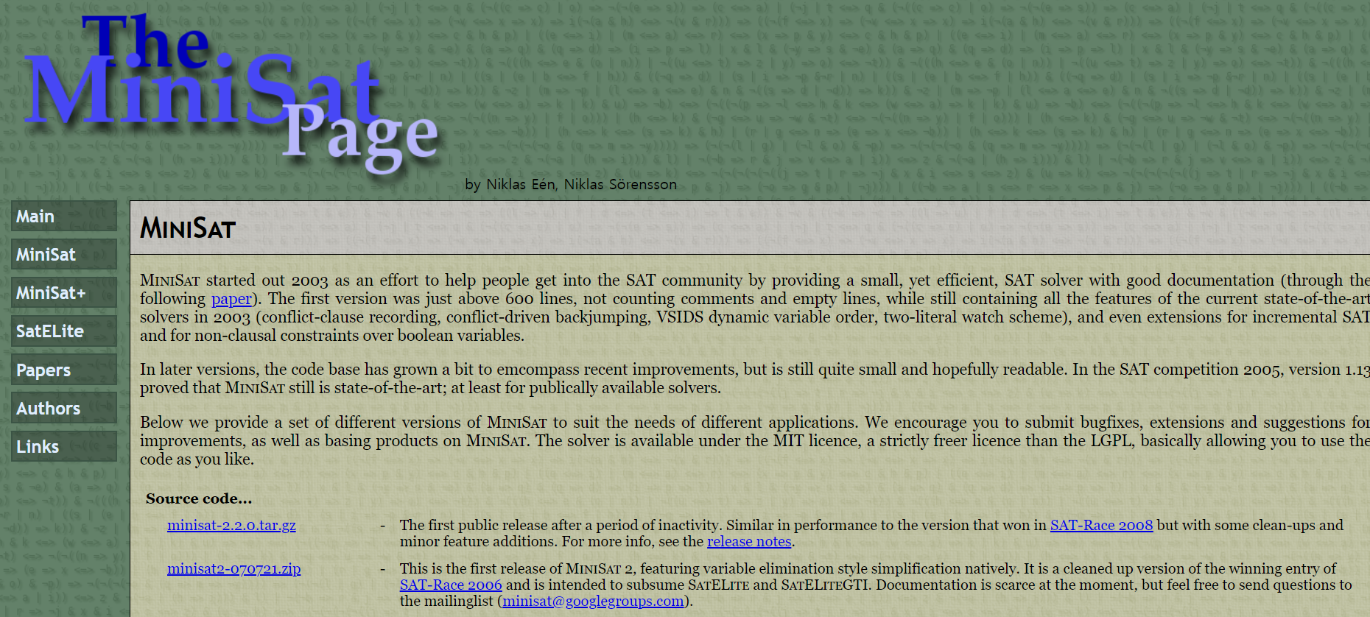
How to install a SAT solver

Slide 6
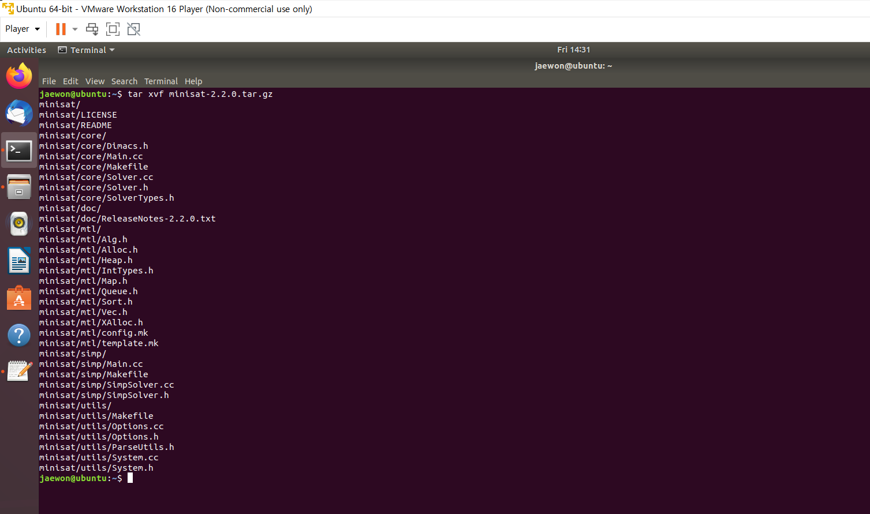
How to set a SAT solver

Slide 7
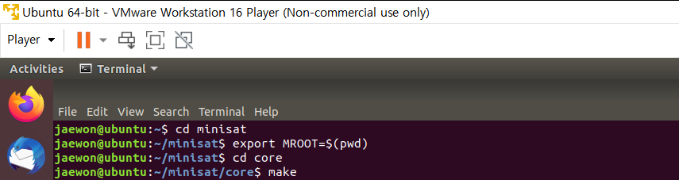
How to set a SAT solver

Slide 8
Satisfiability
A Boolean expression is satisfiable if there is an assignment to the variables that makes it true
Checking to see if a formula S is satisfiable can be done by searching a truth table for a true entry

Slide 9
SAT Solver (MiniSAT)
Input expected in CNF
Use DIMACS CNF format
The input file starts with comments (each line start with c)
The number of variables and the number of clauses defined by the line p cnf #variables #clauses
Each of the next lines specifies a clause: a positive literal is denoted by the corresponding number, and a negative literal is denoted by the corresponding negative number
Each of the next lines specifies a clause: a positive literal is denoted by the corresponding number, and a negative literal is denoted by the corresponding negative number
Use MiniSAT (minisat.se)

Slide 10
SAT Solver (MiniSAT Example)
DIMACS format
(c = comment, ‘p cnf’ = SAT problem in CNF)
C SAT problem in CNF with 2 variables and 2 clauses
p cnf 2 2
-1 -2 0
-1 2 0

Slide 11
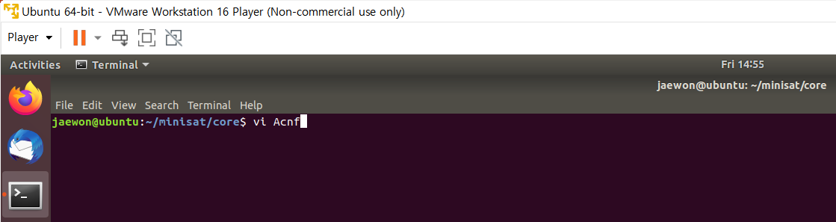
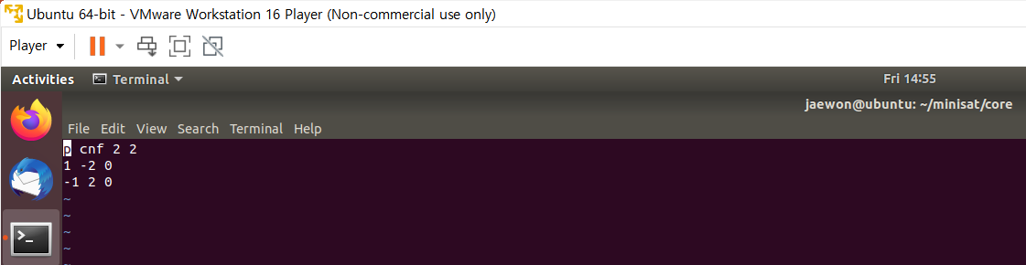
SAT Solver (MiniSAT Example Input)

Slide 12
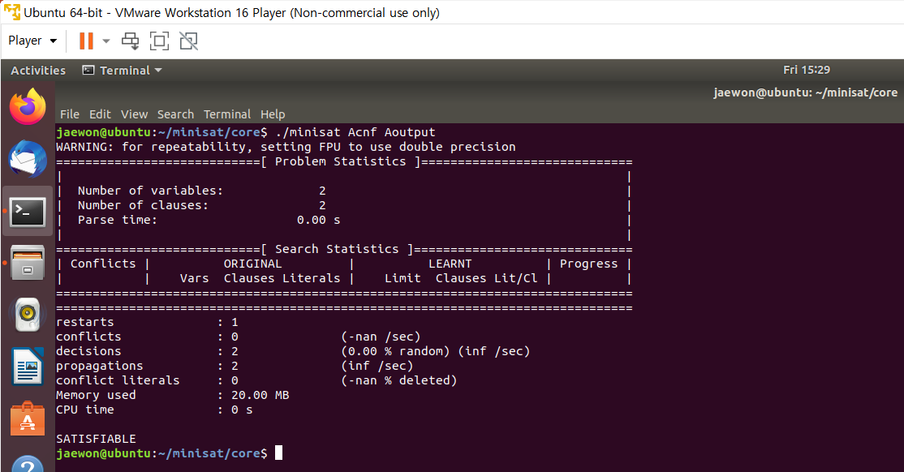
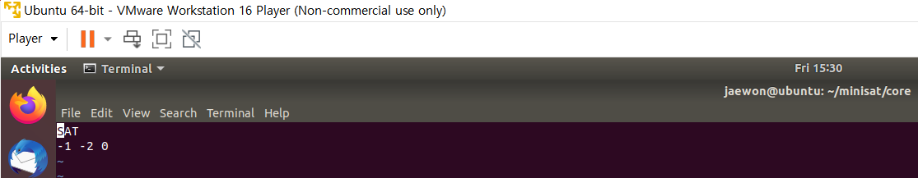
SAT Solver (MiniSAT Example Output)

Slide 13
Pseudo code for
Solving N-Queens using a SAT Solver
void d_d(int x, int y); \\This function will return the lower part of the diagnol when we give x and y values as " i and 0" and "0 and i".
void d_u(int x, int y); \\This function will return the upper part of the diagnol when we give x and y values as " i and 0" and "N-1 and i".
Int main() {
1)We will take the Value of N from the user. 2)We will next Open the file with "w" Permissions. 3)We will append all the elements in the same row and column. 4)We will append the elements in the diagonal down from 0 to N . 5)We will append the elements in the diagonal down from N to 0 . 6)We will append the elements in the diagonal UP from 1 to N . 7)We will append the elements in the diagonal UP from N to 1 .

Slide 14
Pseudo code for
Solving N-Queens using a SAT Solver
8)We will next write the line with "p cnf 'Number of 'Number of values in the Board' 'No.of Clauses' " at the starting of the file.
9)We will send that file as input to Sat Solver to solve 10) We will Store the output cnf file. 11)We now print the generated cnf file in the 2-D Array for the better understanding. 12)The places of the queens where it needs to be placed is shown.
}

Slide 15
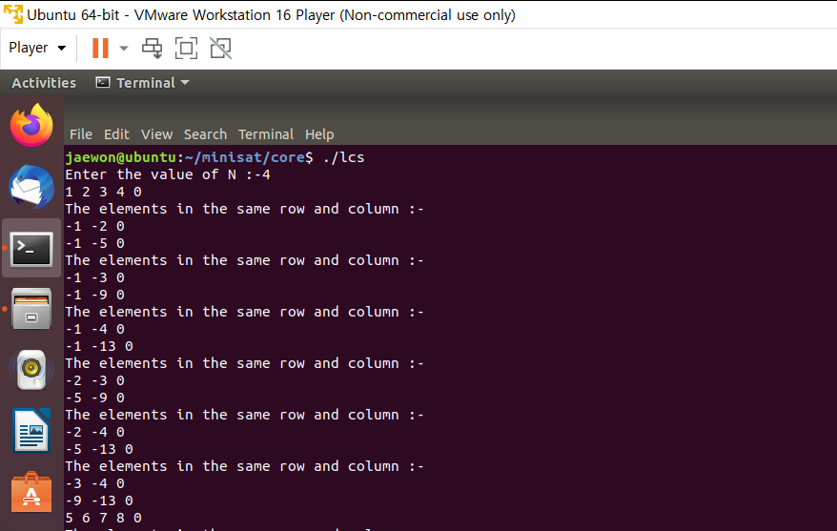
Solving N-Queens using a SAT Solver (Input)

Slide 16
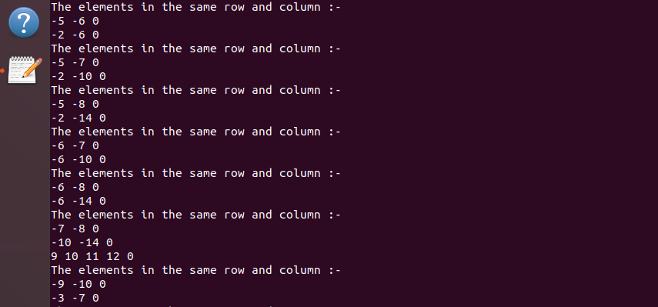
Solving N-Queens using a SAT Solver (Input)

Slide 17
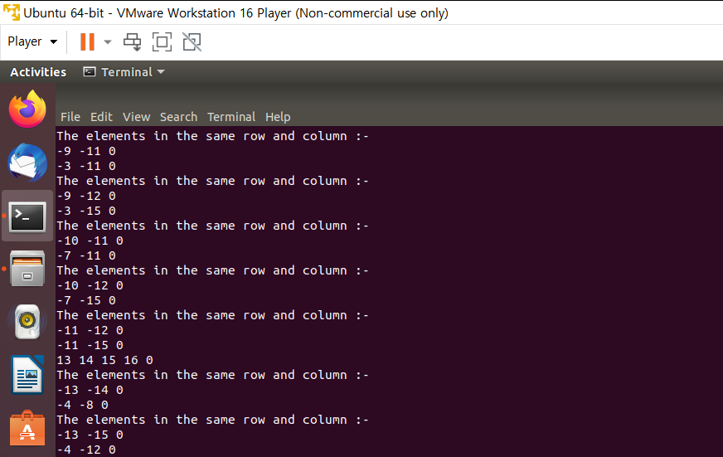
Solving N-Queens using a SAT Solver (Input)

Slide 18
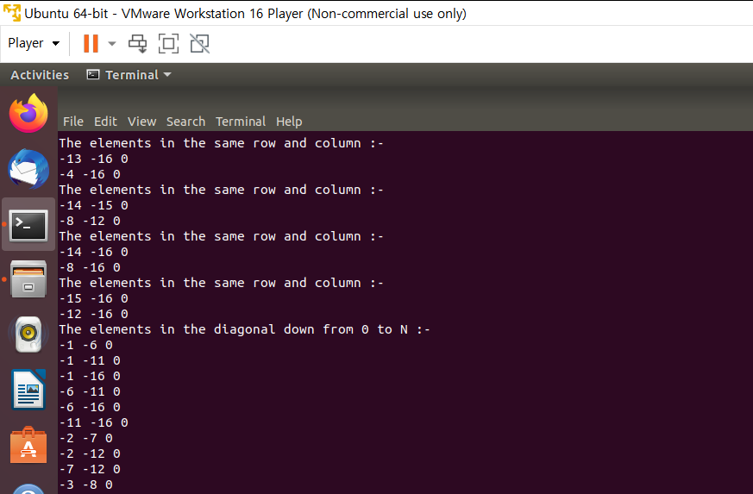
Solving N-Queens using a SAT Solver (Input)

Slide 19
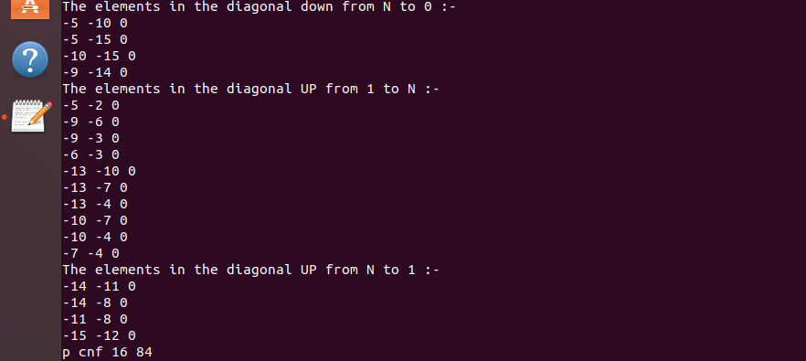
Solving N-Queens using a SAT Solver (Input)

Slide 20

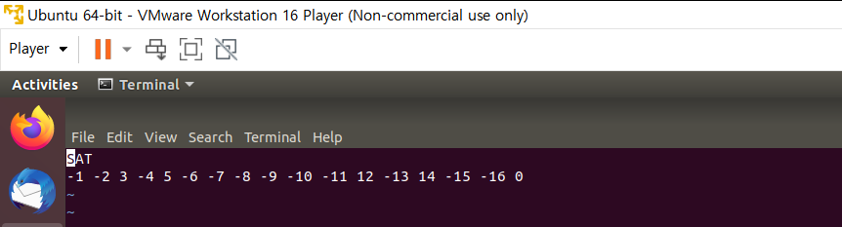
Solving N-Queens using a SAT Solver (Output)

